Slide 1

  lesson 17
  Networking
  Basics

Slide 2
This lesson includes the following sections:
The Uses of a Network
How Networks are Structured
Network Topologies for LANs
Network Media and Hardware
Network Software

Slide 3
The Uses of a Network
A network connects computers so they can communicate, exchange information, and share resources.
The main benefits of using a network are:
Simultaneous Access
Shared Peripheral Devices
Personal Communication
Easier Backup

Slide 4
The Uses of a Network -
Simultaneous Access
In organizations, many people may need to use the same data or programs. A network solves this problem.
Shared data and programs can be stored on a central network server. A server that stores data files may be called a file server.
Managers may assign access rights to users. Some users may only be able to read data, others may be able to make changes to existing files.

Slide 5
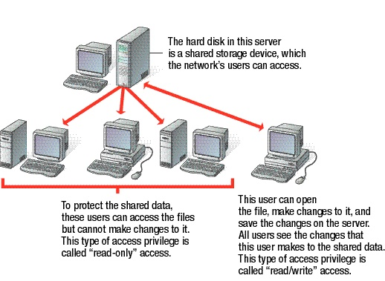
Read/write
Read/write
Read/write
Read/write
Read/write
Read only

Slide 6
The Uses of a Network -
Shared Peripheral Devices
Because peripheral (external) devices like printers can be expensive, it is cost-effective to connect a device to a network so users can share it.
Through a process called spooling, users can send multiple documents (called print jobs) to a networked printer at the same time. The documents are temporarily stored on the server and printed in turn.

Slide 7
The Uses of a Network -
Personal Communication
One of the most common uses of networks is for electronic mail (e-mail).
An e-mail system enables users to exchange written messages (often with data files attached) across the local network or over the Internet.
Two other popular network-based communications systems are teleconferencing and videoconferencing.

Slide 8
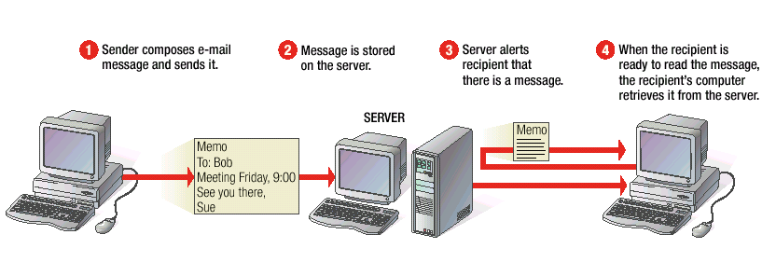
1
2
3
4

Slide 9
The Uses of a Network - Easier Backup
Networks enable managers to easily back up (make backup copies of) important data.
Administrators commonly back up shared data files stored on the server, but may also use the network to back up files on users' PCs.

Slide 10
How Networks are Structured
Local Area Networks (LANs)
Wide Area Networks (WANs)
Server-Based Networks
Client/Server Networks
Peer-to-Peer Networks

Slide 11
How Networks are Structured –
Local Area Networks (LANs)
A LAN is a network whose computers are located relatively near one another. The nodes may be connected by a cable, infrared link, or small transmitters.
A network transmits data among computers by breaking it into small pieces, called packets.
Every LAN uses a protocol – a set of rules that governs how packets are configured and transmitted.

Slide 12
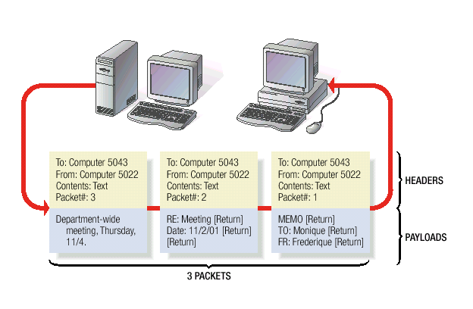

Slide 13
How Networks are Structured –
Wide Area Networks (WANs)
Multiple LANs can be connected together using devices such as bridges, routers, or gateways, which enable them to share data.
A WAN is two or more LANs connected together. The LANs can be many miles apart.
To cover great distances, WANs may transmit data over leased high-speed phone lines or wireless links such as satellites.

Slide 14
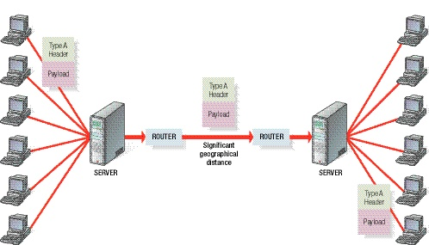
Type A
header
Payload
Type A
header
Payload
ROUTER
ROUTER
Significant
geographical
distance
SERVER
SERVER
Type A
header
Payload
LAN 1
LAN 2
WAN

Slide 15
How Networks are Structured –
Server-Based Networks
In addition to the individual users' PCs (nodes), many networks use a central computer, called a server.
A server has a large hard disk for shared storage. It may provide other services to the nodes, as well.
In a file server network, nodes can access files on the server, but not necessarily on other nodes.

Slide 16
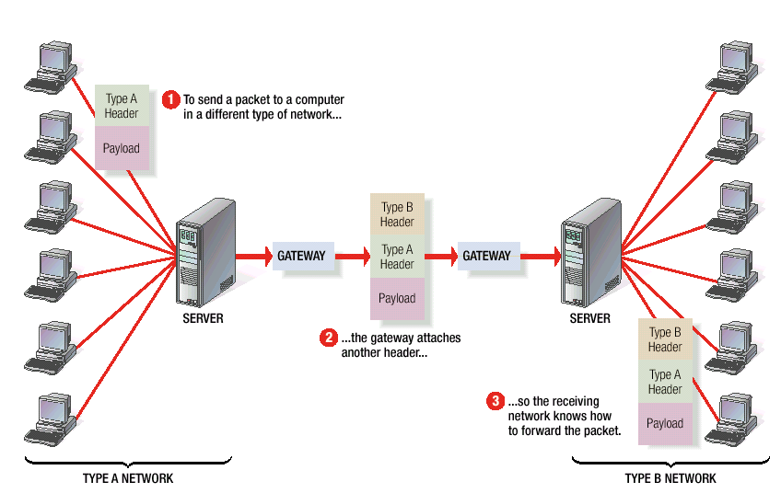
A gateway performs the translation
between two different types of networks.
1
2
3

Slide 17
How Networks are Structured –
Client/Server Networks
In client/server computing, individual nodes share the processing and storage workload with the server.
Client/server networks require specialized software that enables nodes and the server to collaborate on processing and storage, but no special type of network hardware.

Slide 18
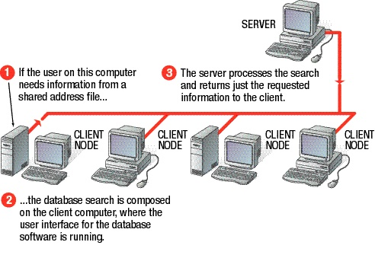
1
3
2

Slide 19
How Networks are Structured –
Peer-to-Peer Networks
In a peer-to-peer network, all nodes have an equal relation to one another.
Each node usually has access to some resources on other nodes, so users can share files, programs, or devices on other users' systems.
Some peer-to-peer networks use a server, but some do not.

Slide 20
Network Topologies for LANs
A network's topology is the layout of the cables and devices that connect the nodes. The four most common network topologies are:
Bus. Each node is connected in series along a single conduit.
Star. All nodes are connected to a central hub.
Ring. Nodes are connected in a circular chain, with the conduit beginning and ending at the same computer.
Mesh. Each node has a separate connection to every other node.

Slide 21
Network Media and Hardware
In a network, the media are the wires, cables and other means by which data travels from its source to its destination.
The most common network media are twisted-pair cable, coaxial cable, fiber-optic cable, and wireless links.
Each node uses a special device, called a network interface card (NIC). The card connects to the network media and controls the flow of data.
NICs must use a common network technology to communicate. The most popular network technologies for LANs are Ethernet, Fast Ethernet, and Token Ring.

Slide 22
Network Software
A network operating system (NOS) is the group of programs that manages the resources on a network.
Common network operating systems for PC-based networks include:
Novell NetWare
Microsoft Windows NT Server
Microsoft Windows 2000
Banyan VINES
AppleShare
Linux

Slide 23
lesson 17 review
List the four benefits of using a network.
Differentiate between LANs and WANs.
Identify three common network topologies.
Name four common network media.
List four examples of network operating systems.

